Slide 1
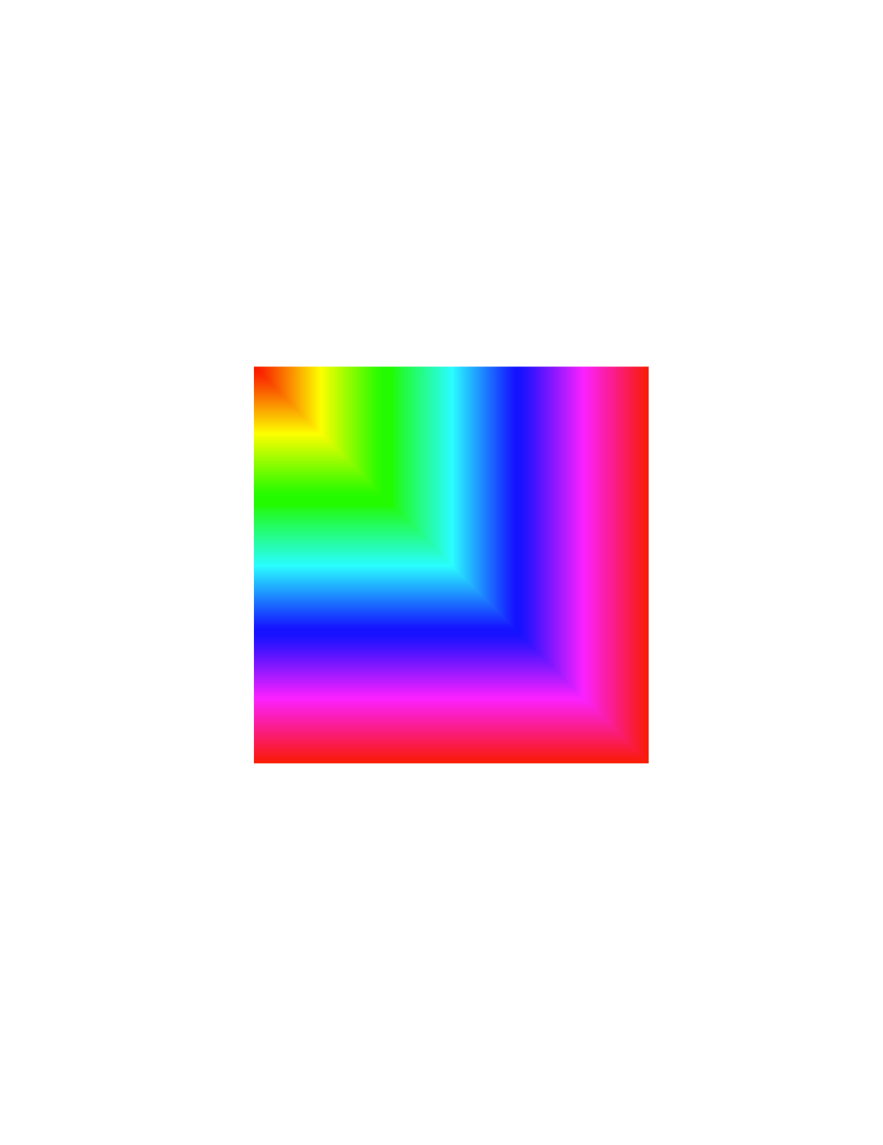
Exercise
Create the following figure.
A 256 by 256 matrix
Colormap(hsv(256))

Slide 2
Solution
clear;
A = zeros(256,256)
for i = 1:256
for j = 1:256
A(i,j) = max(i,j);
end
end
colormap(hsv(256));
image(A)

Slide 3
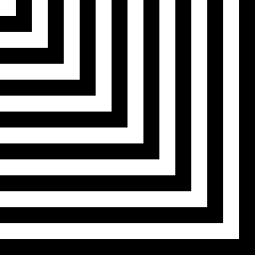
Exercise
Create the following image:
256 by 256 matrix
Colormap(gray(256))
Every 16 pixels, shifts from black to white

Slide 4
Solution
square = zeros(256, 256);
for n = 1:16;
start = (n-1)*16 + 1;
finish = n*16;
if mod(n,2)
square(1:finish, start:finish) = 1;
square(start:finish, 1:finish) = 1;
end
end
square = square*256;
colormap(gray(256));
image(square);

Slide 5
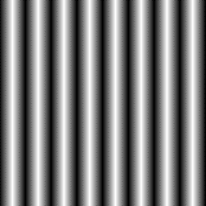
Exercise
Create the following image:
256 by 256 matrix
Colormap(gray(256))
Every 16 pixels, gradually shifts from black to white, then (in the next 16) back to black

Slide 6
Solution
%Columns
square = zeros(256,256);
for n = 1:256
reverse = mod(n,32) >= 16;
shade = mod(n,16);
if ~reverse
square(:,n) = shade*16;
else
square(:,n) = (16-shade)*16;
end
end
image(square);
colormap(gray(256));

Slide 7
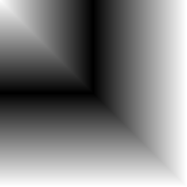
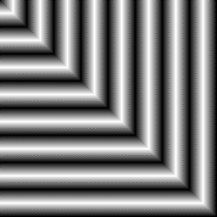
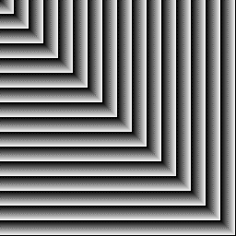
Stuff made while coming up for this exercise.
With help from the last two, create the image below.

Slide 8
Solution
%Combination
square = zeros(256,256);
for n = 1:256
for o = 1:256
larger = max(n,o);
reverse = mod(larger,32) >= 16;
shade = mod(larger,16);
if ~reverse
square(n,o) = shade*16;
else
square(n,o) = (16-shade)*16;
end
end
end
image(square);
colormap(gray(256));

Slide 9
Homework/in class exercises
1. durernoise.m Create a program that creates 5 different versions of the durer image with increasing levels of noise, using the same grayscale(256) CLUT, all in one single image (BMP)
2. rgbnoise.m Create a programm that takes the visionlab jpg logo and presents it in 2 different levels of black and white noise and two different levels of color noise, all in one single image that includes the untouched original.
3. Submit both images and corresponding script files.

Slide 10
Extra-credit
Write a “blocky” color map. That is, one in which the user gets to specify the length and width of the mask (in pixels) as well as the size of each individual “square” of color in the noise image.
+2 points
Submit code and example image with mask of 200 x 200 and squares of 15x15 pixels.
Notes:
10

